Slide 1
Airbnb Machine Learning Project
Curated by: Immanuel Tacky

Slide 2
Project analysis slide 2
Airbnb ML Project
EXPLORATION & ANALYSIS
DATA PREPROCESSING
ML
PROJECT
IMPLEMENTATION
FEATURE SELECTION
& ENGINEERING
PARAMETER RETUNING
MODEL TRAINING
& TESTING

Slide 3
Exploration & Analysis
Overview
VS
price_per_day | price
44.500000 | 106
70.190038 | 152.755053
157.634605 | 240.170260
0.040000 | 10
20.000000 | 69
81.666667 | 175
8000 | 10000
Description: The Airbnb Data set represents the property
listing data of New York City for 2019
Median
Mean
Std
Dataset Size: 48895 entries by 16 columns
Only 4 columns contain missing or NULL values (name, host_name, last_review, reviews_per_month)
11 entries have price listings valued at $0 dollars
The chosen label for model prediction will be price_per_day, which is an engineered feature derived from (price/ minimum_nights)
Min
25%
75%
Max

Slide 4
Overview Continued…
There are 37457 unique host ids out of 48895 entries, indicating that there are hosts with multiple listings
The number of NYC Boroughs utilized in this dataset are 5
The names of the 5 Boroughs are: Brooklyn, Manhattan, Queens, Staten Island, Bronx
The number of unique NYC Neighbourhoods in this dataset are 221
Manhattan and Brooklyn are the most populated Neighbourhood Group for listings while Bronx and Staten Island are amongst the least
Neighbourhood Group | Number of Listings
Manhattan | 21661
Brooklyn | 20104
Queens | 5666
Bronx | 1091
Staten Island | 373

Slide 5
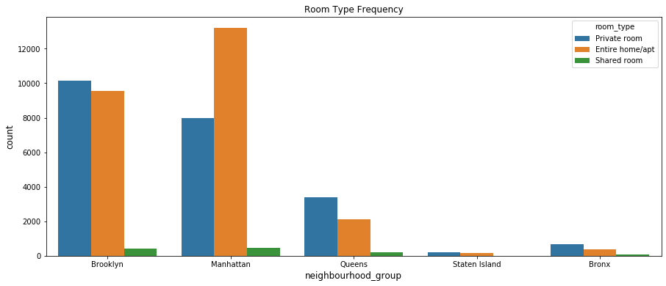
Data Visualization
All neighbourhood groups don’t have many shared room listings
Private rooms are the most available in all groups except Manhattan, where Entire home/apt is the most available
Brooklyn and Manhattan take up a substantial amount of the demand due to location, tourism, etc.

Slide 6
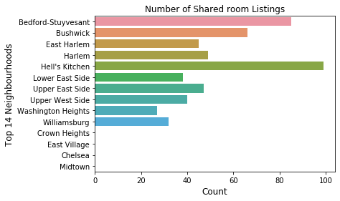
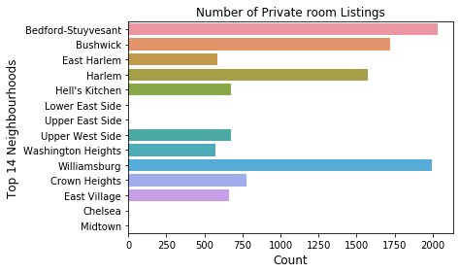
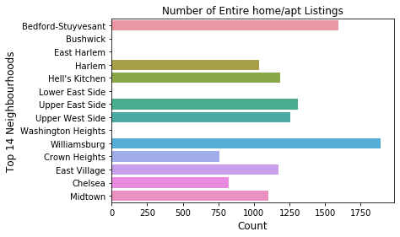
The Top 14 Neighbourhood listings by Room Type

Slide 7
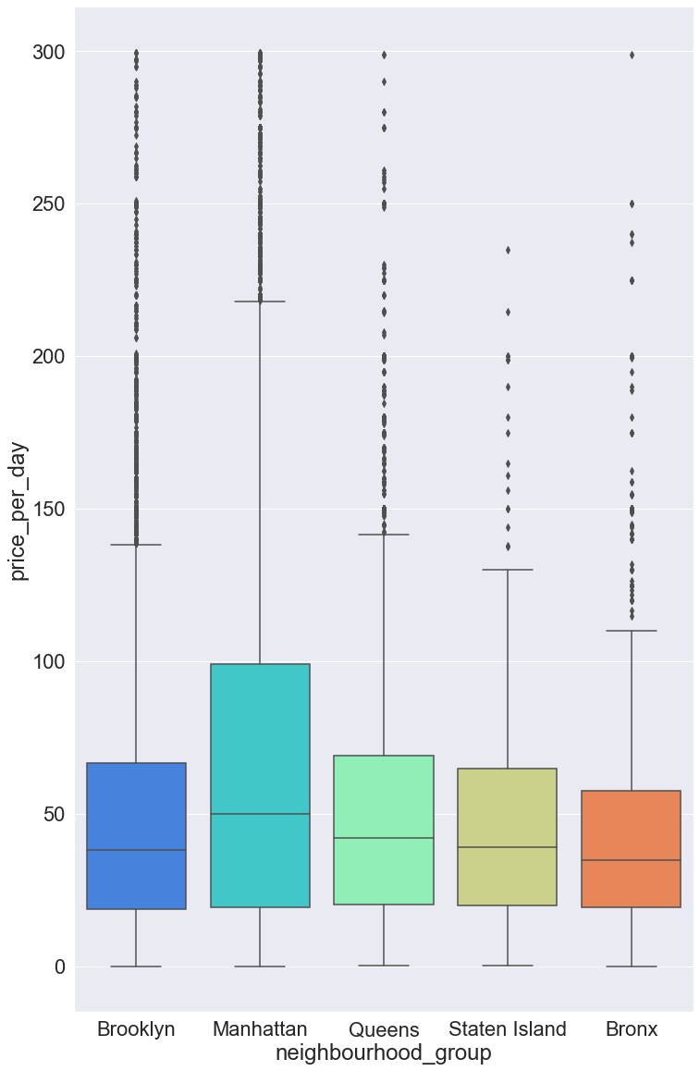
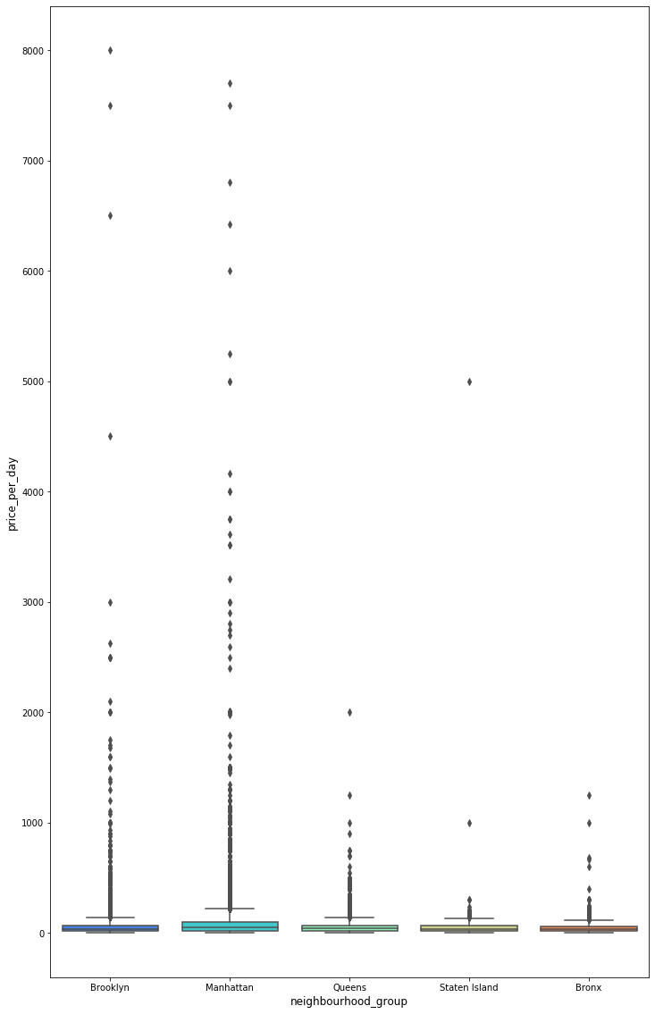
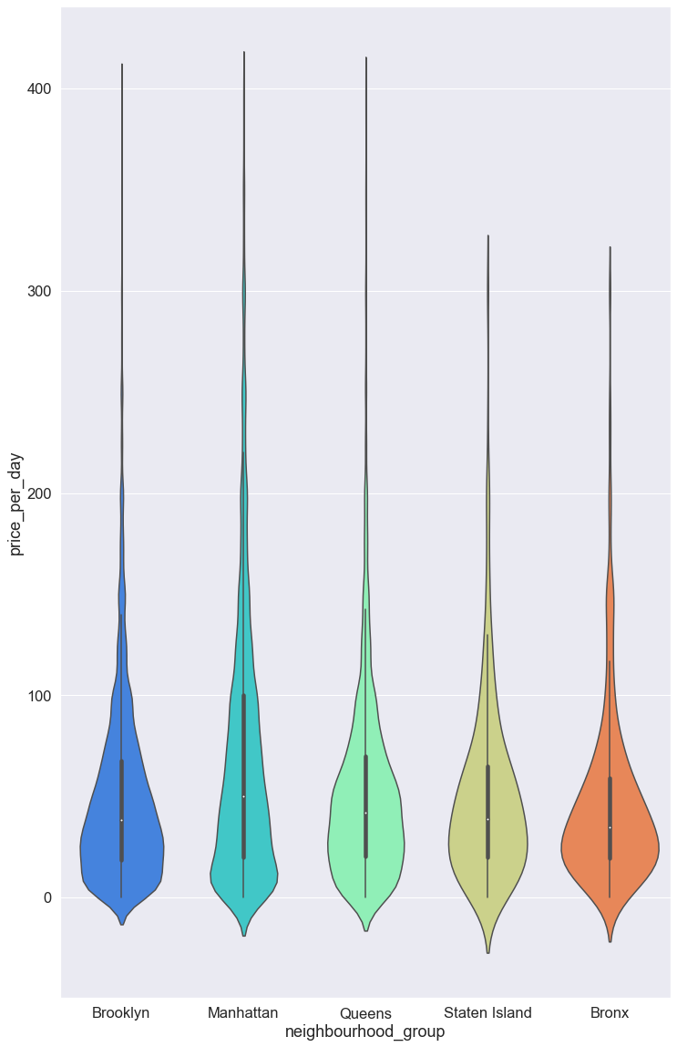
Prices for Each Neighbourhood Group
Full Range

Slide 8
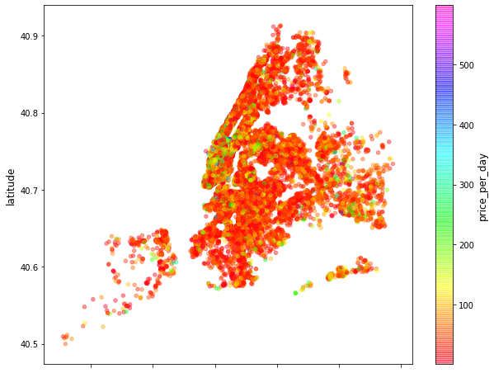
Geographical Representation of Price
Per day
Higher priced listings seem to cluster around specific locations
Most listings are reasonably priced
Manhattan seems to have a very high
concentration of listings within a smaller area, while Brooklyn, as well as the other groups do not as much
Staten Island, and the Bronx are very scarce despite large area
Brooklyn has a high number of listings

Slide 9
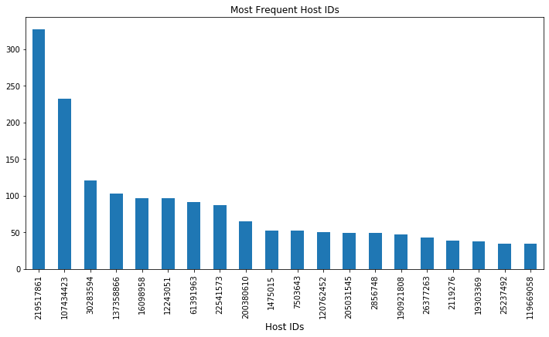
There are few Host IDs that have a substantial amount of property listings
Some single Host ID’s have as much as 50 to over 300 listings

Slide 10
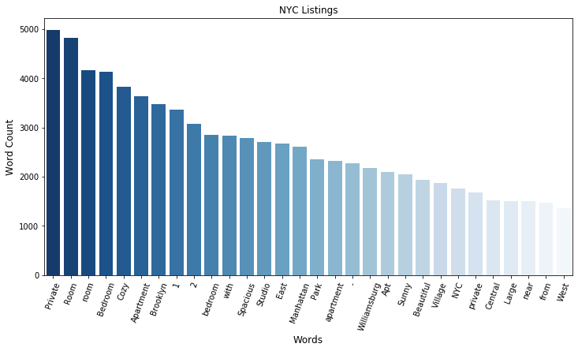
Wordcount for Airbnb
Listings
The purpose of the Wordcount Visualizations are to indicate the potential usefulness in a machine learning model.
Certain keywords may potentially help predict location, the price, or even a price range.

Slide 11
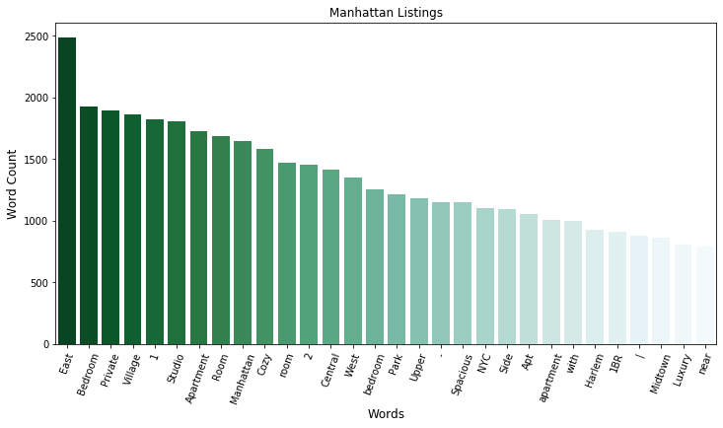
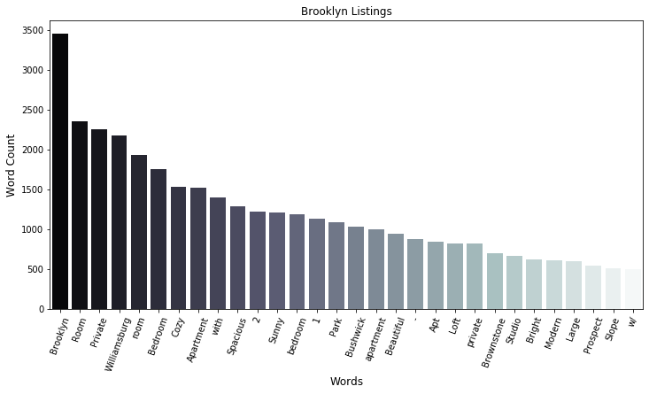

Slide 12
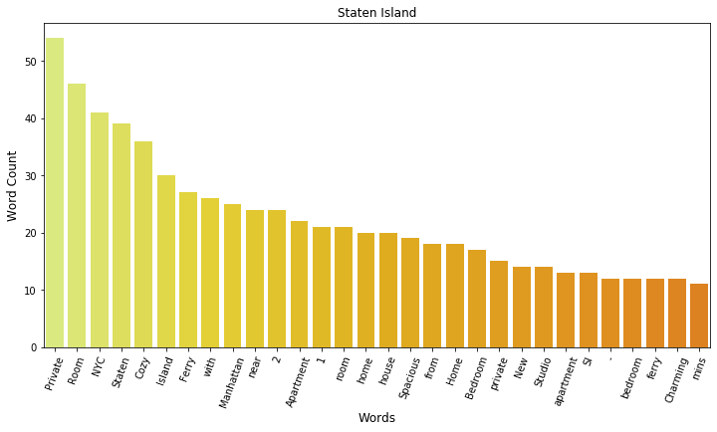
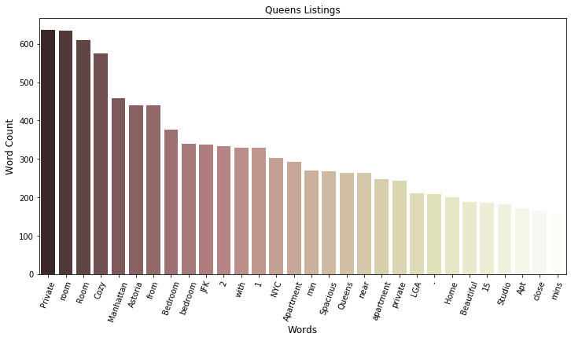
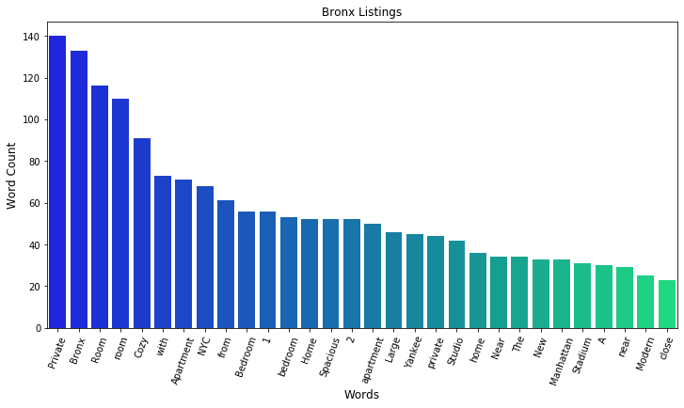

Slide 13
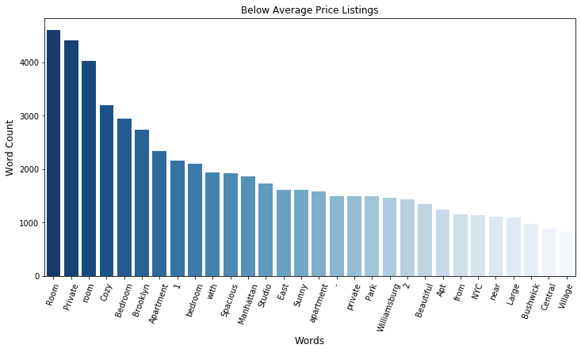
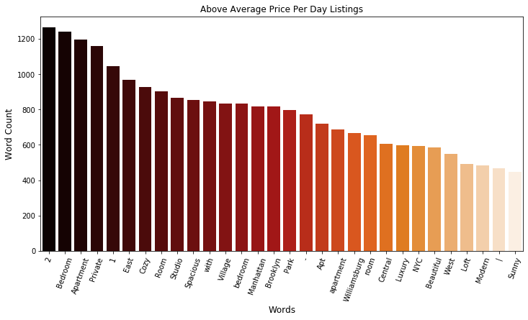
These Visualizations clearly indicate that there are strong correlations between certain keywords and pricing.

Slide 14
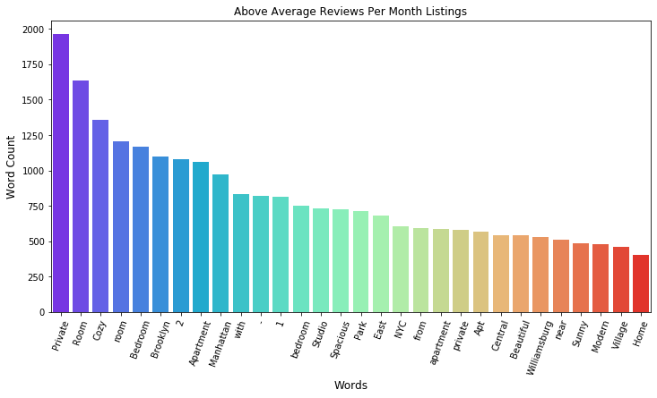
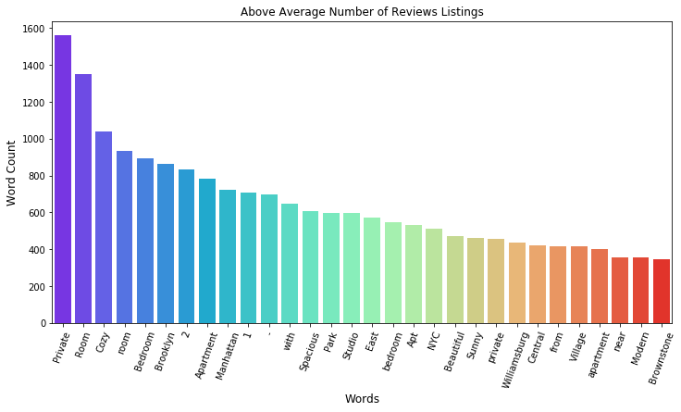

Slide 15
Model Training
& Testing
Label Encoding
Prediction Result Visualization
Model Evaluation
Model Development
Includes:
Setting price_per_day as the predict variable
Create training and testing datasets for model
Standardize data if necessary
Training different Models to find the most optimal
Testing Models

Slide 16
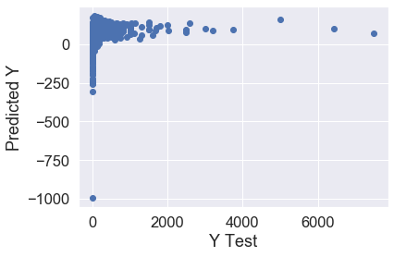
Model Evaluation
Linear Regression Score Accuracy: 0.047089886978461726 MAE: 50.992564942006915 MSE: 19797.355670454395 RMSE: 140.70307626507102 | Elastic-Net Score Accuracy: 0.04335154557895038 MAE: 51.145001783884155 MSE: 19875.02225546842 RMSE: 140.9788007307071
Ridge Regression Score Accuracy: 0.047085442971339764 MAE: 50.971137267420346 MSE: 19797.447997724714 RMSE: 140.70340435726746 | Least Angle Regression Score Accuracy: 0.04708988697845984 MAE: 50.992564942009295 MSE: 19797.355670454435 RMSE: 140.70307626507116
Lasso Score Accuracy: 0.04709296830010867 MAE: 50.99082786982577 MSE: 19797.29165390158 RMSE: 140.70284877678057
The Models we used for this project are Linear Regression, Ridge Regression, Lasso, Elastic Net, and Least Angle Regression.
All of these Models produced nearly congruent results, and failed to yield a prediction accuracy above 5%, or a MAE close to 0.
Prediction Visualization failed to yield any type of recognizable relationship
Conclusion: The Error Rate for the models are too high and needs to be re-evaluated further

Slide 17
Thank You
Airbnb Machine Learning Project

